Slide 1
Chapter 5 – Case Study: Hacker Statistics
DATA SWAT
Data Camp - Intermediate Python for Data Science
December 13, 2016
Aryn Moore

Slide 2






Rules of the game
Roll a die 100 times
1 or 2 = move down 1 step
3 , 4 , 5 = move up 1 step
6 = roll again and move the number of steps designated by that roll
Can’t go below bottom step
0.1% chance of falling down stairs (restart from step 0)
What is the chance that you will reach the 60th step?

Slide 3
Numpy Random Functions
rand function - np.random.rand()
Generates a random float between 0 and 1
randint - np.random.randint()
Generates a random integer
Must designate range range from which to pick
Use this to simulate roll of die: np.random.randint(1,7)
seed - np.random.seed()
Allows for the same random numbers to be used when same seed designated
Allows for reproducible results

Slide 4
Determine next move
import numpy as np
np.random.seed(123)
step = 50
dice = np.random.randint(1,7)
if dice <= 2 :
step = step - 1
elif dice <= 5 :
step = step + 1
else :
step = step + np.random.randint(1,7)
print(dice)
print(step)
<script.py> output:
6
53

Slide 5
Random Walk
Random walk = succession of random steps (e.g. determined by rolling dice)
Each step based upon the previous step
For this game, each sequence of rolling the die 100 times is a random walk

Slide 6
import numpy as np
np.random.seed(123)
random_walk = [0]
for x in range(100) :
step = random_walk[-1]
dice = np.random.randint(1,7)
if dice <= 2:
step = step - 1
elif dice <= 5:
step = step + 1
else:
step = step + np.random.randint(1,7)
random_walk.append(step)
print(random_walk)
<script.py> output:
[0, 3, 4, 5, 4, 5, 6, 7, 6, 5, 4, 3, 2, 1, 0, -1, 0, 5, 4, 3, 4, 3, 4, 5, 6, 7, 8, 7, 8, 7, 8, 9, 10, 11, 10, 14, 15, 14, 15, 14, 15, 16, 17, 18, 19, 20, 21, 24, 25, 26, 27, 32, 33, 37, 38, 37, 38, 39, 38, 39, 40, 42, 43, 44, 43, 42, 43, 44, 43, 42, 43, 44, 46, 45, 44, 45, 44, 45, 46, 47, 49, 48, 49, 50, 51, 52, 53, 52, 51, 52, 51, 52, 53, 52, 55, 56, 57, 58, 57, 58, 59]

Slide 7
Can’t go below bottom step
import numpy as np
np.random.seed(123)
random_walk = [0]
for x in range(100) :
step = random_walk[-1]
dice = np.random.randint(1,7)
if dice <= 2:
step = max(0, step - 1)
elif dice <= 5:
step = step + 1
else:
step = step + np.random.randint(1,7)
random_walk.append(step)
print(random_walk)
<script.py> output:
[0, 3, 4, 5, 4, 5, 6, 7, 6, 5, 4, 3, 2, 1, 0, 0, 1, 6, 5, 4, 5, 4, 5, 6, 7, 8, 9, 8, 9, 8, 9, 10, 11, 12, 11, 15, 16, 15, 16, 15, 16, 17, 18, 19, 20, 21, 22, 25, 26, 27, 28, 33, 34, 38, 39, 38, 39, 40, 39, 40, 41, 43, 44, 45, 44, 43, 44, 45, 44, 43, 44, 45, 47, 46, 45, 46, 45, 46, 47, 48, 50, 49, 50, 51, 52, 53, 54, 53, 52, 53, 52, 53, 54, 53, 56, 57, 58, 59, 58, 59, 60]

Slide 8
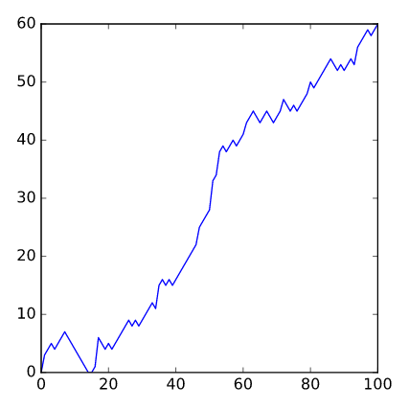
Plot the Walk (matplotlib)
import numpy as np
np.random.seed(123)
random_walk = [0]
for x in range(100) :
step = random_walk[-1]
dice = np.random.randint(1,7)
if dice <= 2:
step = max(0, step - 1)
elif dice <= 5:
step = step + 1
else:
step = step + np.random.randint(1,7)
random_walk.append(step)
import matplotlib.pyplot as plt
plt.plot(random_walk)
plt.show()

Slide 9
Distribution of Random Walks
Random walk depends on the sequence of die values thrown
What is the chance you reach 60th step?
Each random walk ends on a different step
Simulate walk 1000s of times, you get 1000s of final steps
Distribution of final steps
Use this distribution to calculate chances

Slide 10
Steps reached in 100 Random Walks
import numpy as np
np.random.seed(123)
all_walks = []
for i in range(10) :
random_walk = [0]
for x in range(100) :
step = random_walk[-1]
dice = np.random.randint(1,7)
if dice <= 2:
step = max(0, step - 1)
elif dice <= 5:
step = step + 1
else:
step = step + np.random.randint(1,7)
random_walk.append(step)
all_walks.append(random_walk)
print(all_walks)

Slide 11
Results (steps reached)
[[0, 3, 4, 5, 4, 5, 6, 7, 6, 5, 4, 3, 2, 1, 0, 0, 1, 6, 5, 4, 5, 4, 5, 6, 7, 8, 9, 8, 9, 8, 9, 10, 11, 12, 11, 15, 16, 15, 16, 15, 16, 17, 18, 19, 20, 21, 22, 25, 26, 27, 28, 33, 34, 38, 39, 38, 39, 40, 39, 40, 41, 43, 44, 45, 44, 43, 44, 45, 44, 43, 44, 45, 47, 46, 45, 46, 45, 46, 47, 48, 50, 49, 50, 51, 52, 53, 54, 53, 52, 53, 52, 53, 54, 53, 56, 57, 58, 59, 58, 59, 60], [0, 4, 3, 2, 4, 3, 4, 6, 7, 8, 13, 12, 13, 14, 15, 16, 17, 16, 21, 22, 23, 24, 23, 22, 21, 20, 19, 20, 21, 22, 28, 27, 26, 25, 26, 27, 28, 27, 28, 29, 28, 33, 34, 33, 32, 31, 30, 31, 30, 29, 31, 32, 35, 36, 38, 39, 40, 41, 40, 39, 40, 41, 42, 43, 42, 43, 44, 45, 48, 49, 50, 49, 50, 49, 50, 51, 52, 56, 55, 54, 55, 56, 57, 56, 57, 56, 57, 59, 64, 63, 64, 65, 66, 67, 68, 69, 68, 69, 70, 71, 73], [0, 2, 1, 2, 3, 6, 5, 6, 5, 6, 7, 8, 7, 8, 7, 8, 9, 11, 10, 9, 10, 11, 10, 12, 13, 14, 15, 16, 17, 18, 17, 18, 19, 24, 25, 24, 23, 22, 21, 22, 23, 24, 29, 30, 29, 30, 31, 32, 33, 34, 35, 34, 33, 34, 33, 39, 38, 39, 38, 39, 38, 39, 43, 47, 49, 51, 50, 51, 53, 52, 58, 59, 61, 62, 61, 62, 63, 64, 63, 64, 65, 66, 68, 67, 66, 67, 73, 78, 77, 76, 80, 81, 82, 83, 85, 84, 85, 84, 85, 84, 83], [0, 6, 5, 6, 7, 8, 9, 10, 11, 12, 13, 12, 13, 12, 11, 12, 11, 12, 11, 12, 13, 17, 18, 17, 23, 22, 21, 22, 21, 20, 21, 20, 24, 23, 24, 23, 24, 23, 24, 26, 25, 24, 23, 24, 23, 28, 29, 30, 29, 28, 29, 28, 29, 28, 33, 34, 33, 32, 31, 30, 31, 32, 36, 42, 43, 44, 45, 46, 45, 46, 48, 49, 50, 51, 50, 49, 50, 49, 50, 51, 52, 51, 52, 53, 54, 53, 52, 53, 54, 59, 60, 61, 66, 65, 66, 65, 66, 67, 68, 69, 68], [0, 6, 5, 6, 5, 4, 5, 9, 10, 11, 12, 13, 12, 11, 10, 9, 8, 9, 10, 11, 12, 13, 14, 13, 14, 15, 14, 15, 16, 19, 18, 19, 18, 19, 22, 23, 24, 25, 24, 23, 26, 27, 28, 29, 28, 27, 28, 31, 32, 37, 38, 37, 38, 37, 38, 37, 43, 42, 41, 42, 44, 43, 42, 41, 42, 43, 44, 45, 49, 54, 55, 56, 57, 60, 61, 62, 63, 64, 65, 66, 65, 64, 65, 66, 65, 71, 70, 71, 72, 71, 70, 71, 70, 69, 75, 74, 73, 74, 75, 74, 73], [0, 0, 0, 1, 7, 8, 11, 12, 18, 19, 20, 26, 25, 31, 30, 31, 32, 33, 32, 38, 39, 38, 39, 38, 39, 38, 39, 38, 39, 43, 44, 46, 45, 46, 45, 44, 45, 44, 45, 44, 48, 52, 51, 50, 49, 50, 51, 55, 56, 57, 61, 60, 59, 58, 59, 60, 62, 61, 60, 61, 62, 64, 67, 72, 73, 72, 73, 74, 75, 76, 77, 76, 77, 78, 84, 83, 88, 87, 91, 90, 94, 93, 96, 97, 96, 97, 103, 102, 101, 100, 104, 103, 102, 103, 104, 103, 104, 105, 106, 107, 106], [0, 0, 0, 1, 0, 0, 4, 5, 7, 11, 17, 16, 15, 16, 17, 18, 17, 18, 17, 18, 19, 18, 17, 18, 19, 20, 21, 22, 23, 24, 25, 26, 27, 33, 32, 35, 36, 35, 34, 35, 36, 37, 36, 35, 34, 33, 34, 35, 36, 37, 38, 39, 40, 39, 40, 41, 43, 42, 43, 44, 47, 49, 50, 49, 48, 47, 46, 45, 46, 45, 46, 48, 49, 50, 49, 50, 49, 48, 49, 48, 47, 46, 47, 46, 45, 46, 47, 48, 50, 51, 52, 51, 50, 51, 57, 56, 57, 58, 63, 62, 63], [0, 0, 1, 2, 1, 2, 3, 9, 10, 11, 12, 11, 13, 14, 15, 16, 15, 16, 17, 18, 19, 18, 19, 18, 19, 20, 19, 20, 24, 25, 28, 29, 33, 34, 33, 34, 35, 34, 33, 38, 39, 40, 39, 38, 39, 40, 41, 40, 44, 43, 44, 45, 46, 47, 48, 49, 50, 49, 48, 47, 48, 49, 53, 54, 53, 54, 55, 54, 60, 61, 62, 63, 62, 63, 64, 67, 66, 67, 66, 65, 64, 65, 66, 68, 69, 70, 74, 75, 74, 73, 74, 75, 74, 73, 74, 75, 76, 75, 74, 75, 76], [0, 1, 0, 1, 2, 1, 0, 0, 1, 2, 3, 4, 5, 10, 14, 13, 14, 13, 12, 11, 12, 11, 12, 13, 12, 16, 17, 16, 17, 16, 15, 16, 15, 19, 20, 21, 22, 23, 24, 23, 24, 25, 26, 27, 28, 27, 32, 33, 34, 33, 34, 33, 34, 35, 34, 35, 40, 41, 42, 41, 42, 43, 44, 43, 44, 43, 44, 45, 44, 43, 42, 43, 44, 43, 42, 41, 42, 46, 47, 48, 49, 50, 51, 50, 51, 52, 51, 52, 57, 58, 57, 56, 57, 56, 55, 54, 58, 59, 60, 61, 60], [0, 1, 2, 3, 4, 5, 4, 3, 6, 5, 4, 3, 2, 3, 9, 10, 9, 10, 11, 10, 9, 10, 11, 12, 11, 15, 16, 15, 17, 18, 17, 18, 19, 20, 21, 22, 23, 22, 21, 22, 23, 22, 23, 24, 23, 22, 21, 25, 26, 27, 28, 29, 30, 31, 32, 33, 34, 33, 34, 35, 36, 37, 38, 37, 36, 42, 43, 44, 43, 42, 41, 45, 46, 50, 49, 55, 56, 57, 61, 62, 61, 60, 61, 62, 63, 64, 63, 69, 70, 69, 73, 74, 73, 74, 73, 79, 85, 86, 85, 86, 87]]

Slide 12
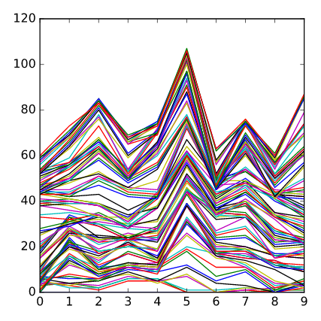
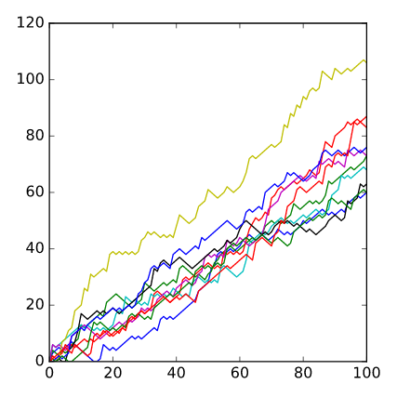
Visualize (10 Random Walks)
import matplotlib.pyplot as plt
import numpy as np
np.random.seed(123)
all_walks = []
for i in range(10) :
random_walk = [0]
for x in range(100) :
step = random_walk[-1]
dice = np.random.randint(1,7)
if dice <= 2:
step = max(0, step - 1)
elif dice <= 5:
step = step + 1
else:
step = step + np.random.randint(1,7)
random_walk.append(step)
all_walks.append(random_walk)
np_aw = np.array(all_walks)
np_aw_t = np.transpose(np_aw)
plt.plot(np_aw_t)
plt.show()

Slide 13
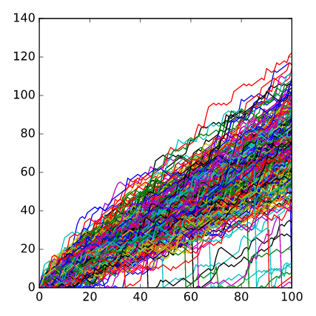
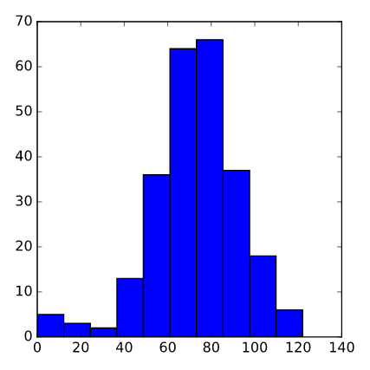
Include Clumsiness (250 Random Walks)
import matplotlib.pyplot as plt
import numpy as np
np.random.seed(123)
all_walks = []
for i in range(250) :
random_walk = [0]
for x in range(100) :
step = random_walk[-1]
dice = np.random.randint(1,7)
if dice <= 2:
step = max(0, step - 1)
elif dice <= 5:
step = step + 1
else:
step = step + np.random.randint(1,7)
if np.random.rand() <= 0.001 :
step = 0
random_walk.append(step)
all_walks.append(random_walk)
np_aw_t = np.transpose(np.array(all_walks))
plt.plot(np_aw_t)
plt.show()

Slide 14
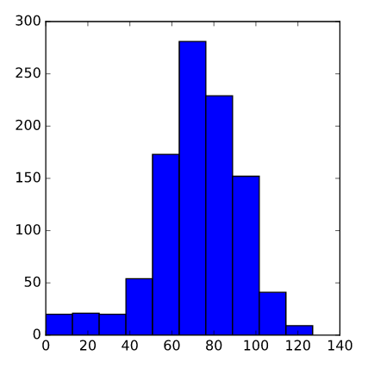
Plot Distribution of Final Steps Reached
import matplotlib.pyplot as plt
import numpy as np
np.random.seed(123)
all_walks = []
for i in range(1000) :
random_walk = [0]
for x in range(100) :
step = random_walk[-1]
dice = np.random.randint(1,7)
if dice <= 2:
step = max(0, step - 1)
elif dice <= 5:
step = step + 1
else:
step = step + np.random.randint(1,7)
if np.random.rand() <= 0.001 :
step = 0
random_walk.append(step)
all_walks.append(random_walk)
np_aw_t = np.transpose(np.array(all_walks))
ends = np_aw_t[-1,:]
plt.hist(ends)
plt.show()

Slide 15
Calculate the Odds
In [1]: np.mean(ends > 59)
Out[1]: 0.78800000000000003
In [2]: from collections import Counter
In [3]: Counter(ends>=60)
Out[3]: Counter({False: 212, True: 788})
In [4]: sum(i>=60 for i in ends)
Out[4]: 788

